Slide 1
CSC 236
Tutorial Number 5 - Daniel Razavi

Slide 2
Michelle Says Hi!

Slide 3
I will have these slides up on my website

Slide 4
Today’s Problem Set

Slide 5
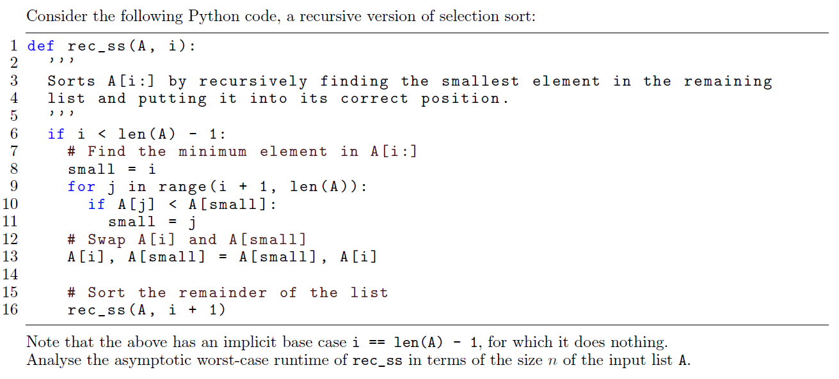
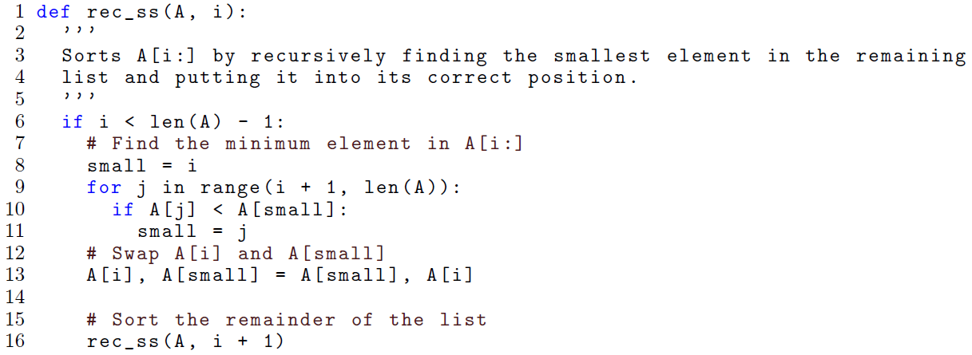

Slide 6
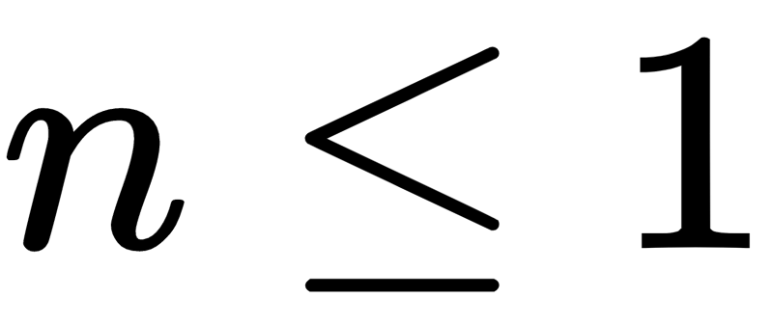
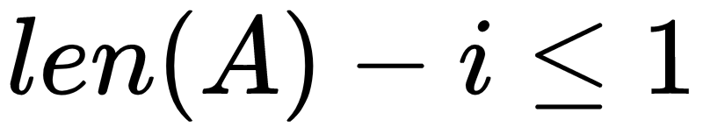
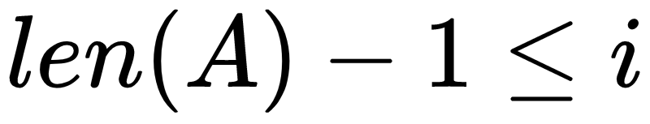
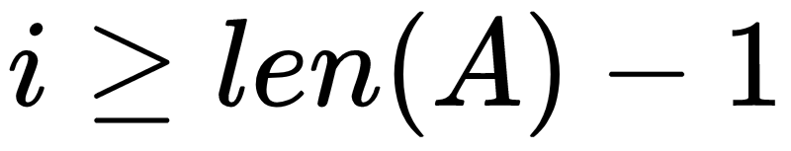
Let T(n) be the worst-case running time of rec_ss,
where n = len(A) - i
If
Then
Or
Or
in this case, the function does constant c amount of work: the only thing the function does is check the if-condition and return.

Slide 7
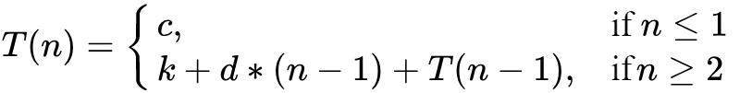
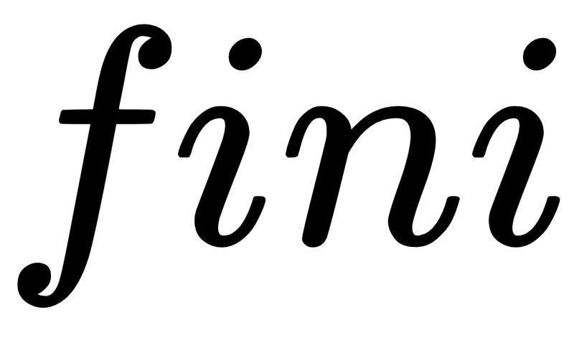
For n > 1, we do some constant k amount of work to check the first if-condition.
Then, in the for-loop, we do work proportional to len(A) - i - 1 = n-1
amount of work. Then, we do T(n-1) work in the recursive call. This gives us:
Note that the k is mostly optional here: we could absorb that into the d(n-1) term by letting d0 = d+k, for example.
One liner codes here and there
What's inside the for loop
For the recursive call
Notes:
T(n)=
\begin{cases}
c,& \text{if } n \le 1\\
k + d*(n-1) + T(n-1), & \text{if}n\ge 2\ \end{cases}

Slide 8
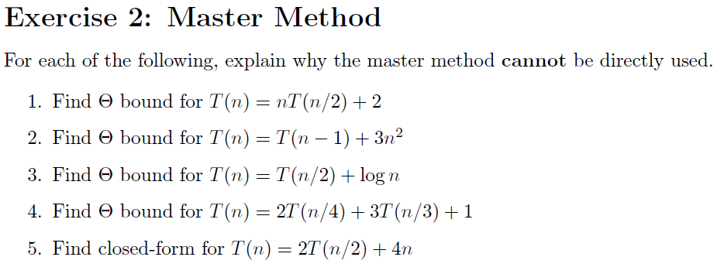
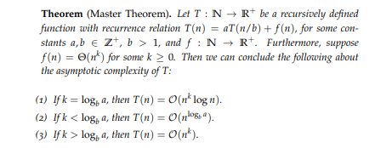

Slide 9
The coefficient in front of T(n/2) is required to be a constant; n is not a constant, so the master method cannot be used

Slide 11
For the restricted version of the master method that we're using, we require that the terms not involving T(n) be Theta(n^k); here we have log n, which is NOT Theta(n^k) for any k.
(For an O bound, we could upper-bound the log n term by n, but this isn't a Theta bound anymore.)

Slide 12
The master method cannot be used when different-sized recursive calls are made. (There's an example at the end of lecture 5 showing that we can still use it to find an O bound by replacing smaller recursive calls with larger ones, but this won't give a Theta bound anymore.)

Slide 13
The master method cannot be used to find an exact closed-form, only an asymptotic bound.

Slide 14
CSC 236
Tutorial Number 5 - Daniel Razavi

